Slide 1
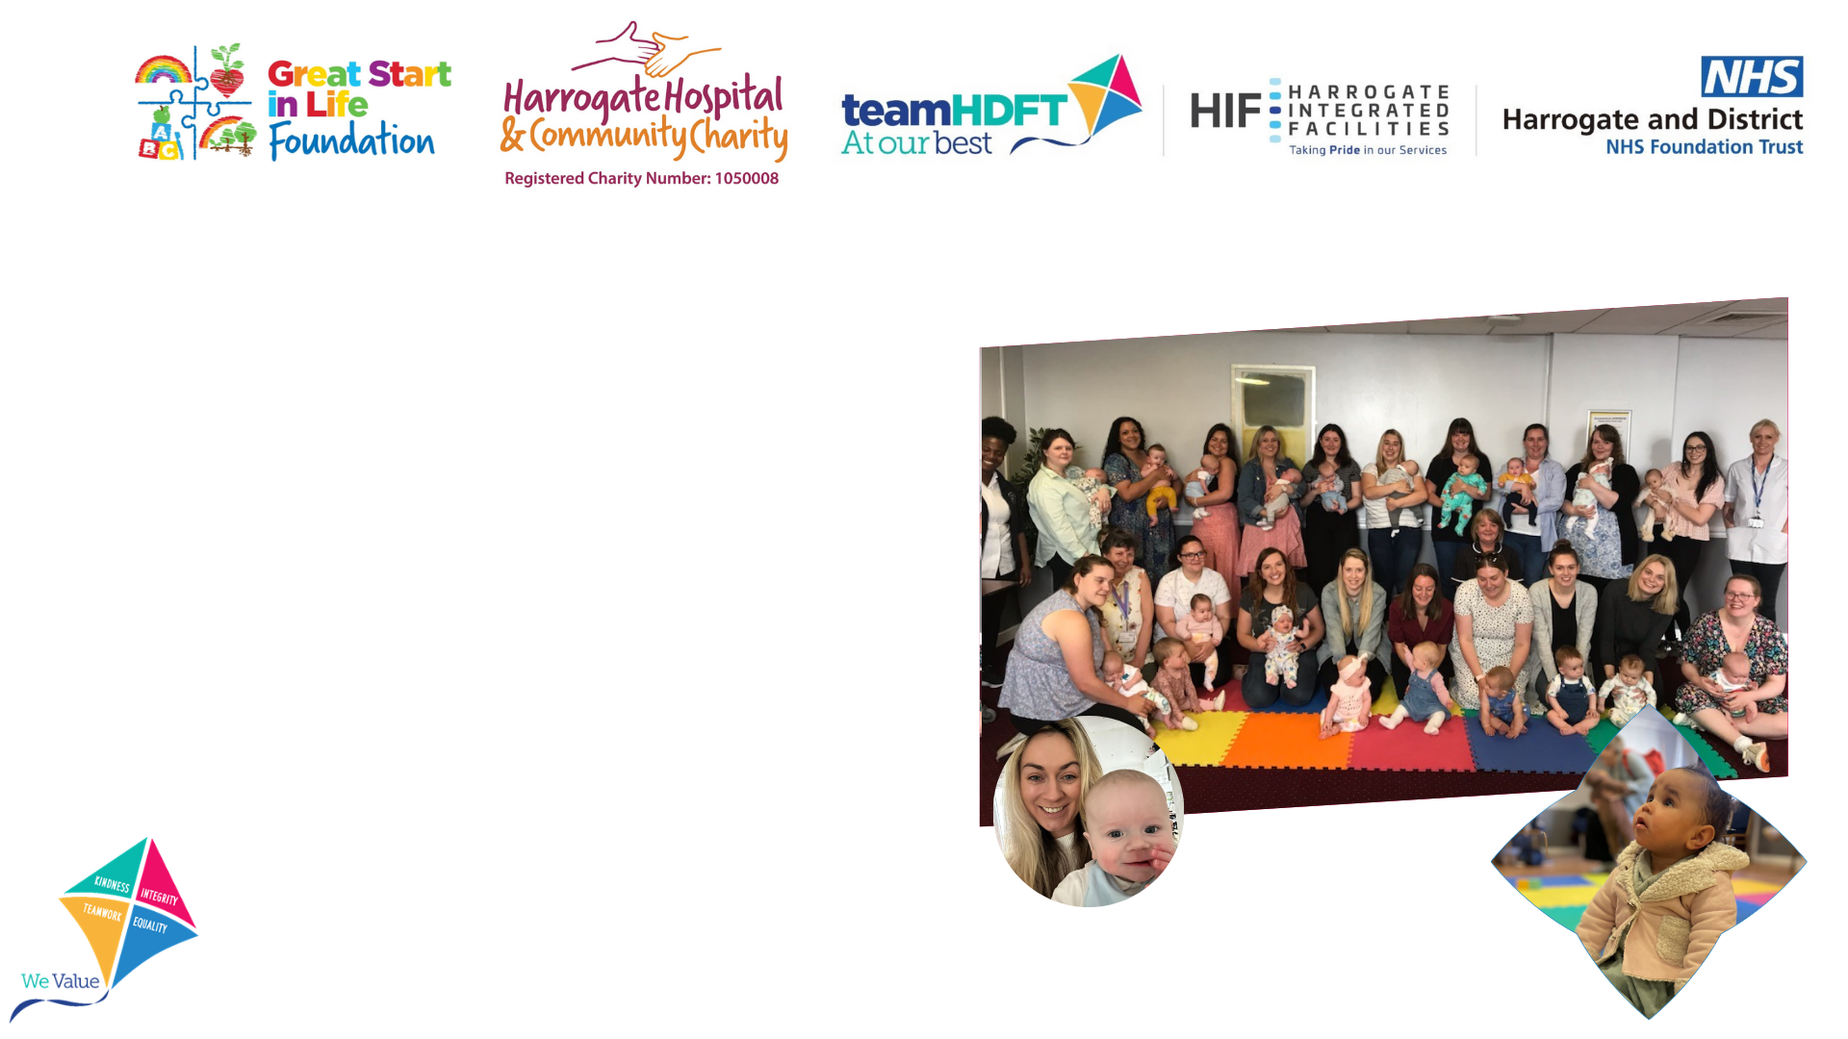
Children’s Public Health Services Strategy

Slide 2

Introduction
Harrogate and District NHS Foundation Trust’s (HDFT) reputation for quality and innovation has enabled us to become the largest provider of Children’s Public Health Services (often known as 0–19 or 0-25 Services) in England – we support over 600,000 Children and Young People through our nine services stretching from Berwick upon Tweed in the North, to Wakefield in the South, and across the whole of North Yorkshire, from Settle in the West to Scarborough in the East.
Our new Children’s Public Health Services Strategy will fully support our Trust Purpose to improve the health and wellbeing of our patients, children and communities.
Our Strategy reflects our True North Ambitions and aspiration to lead the development of Children and Young People’s public health nursing services by sharing our expertise to benefit Children and Young People nationally. It provides a framework to align our improvement efforts to our Trust purpose, ambitions and values.

Slide 3
Introduction
It is a very exciting time for HDFT as we embark on a number of large scale transformation programmes. We are committed to embedding continuous improvement at the heart of our culture and operating model and we are working in partnership with a global leader in healthcare improvement to deliver “HDFT Impact”, our Trust wide improvement programme.
Through HDFT Impact, we will focus on how we measure the Quality and Impact of our 0-19(25) Services. We have identified metrics to track improvement against our ‘Great Start In Life’ True North Ambition which cover early intervention and prevention for children at risk of vulnerability and listening to and acting on children and young people’s experience.
The aim of our Strategy is to empower, excite and mobilise everyone in the Trust behind our common purpose, supported by our “KITE” values of Kindness, Integrity, Teamwork and Equality. By aligning our efforts, our Strategy will enable us to work together with everyone pulling in the same direction, so we become stronger, achieve our ambitions and fulfil our purpose – to put the Child and Young Person first and improve the health and wellbeing of our Children, Young People, Families and Communities.

Slide 4
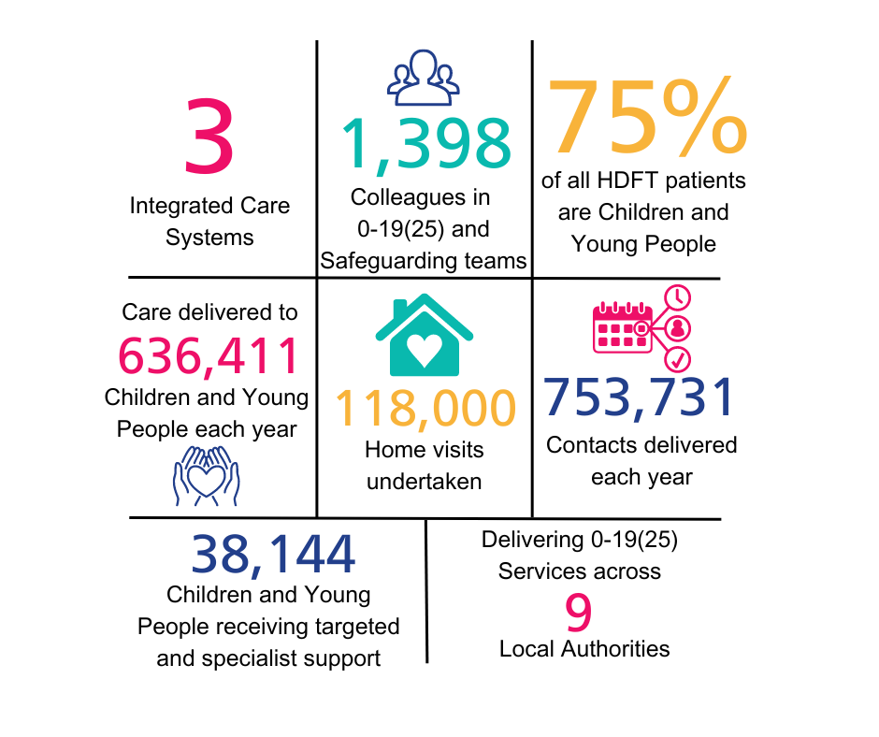
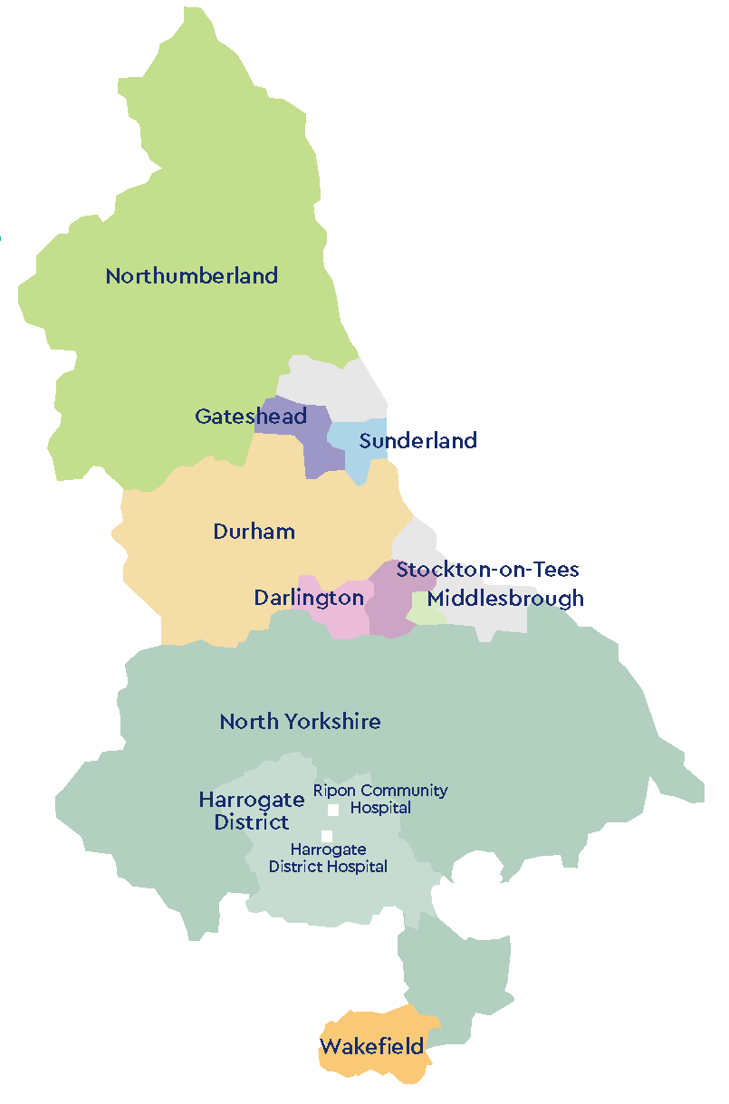
About HDFT Children’s Public Health Service

Slide 5

Who We Engaged With To Develop Our Strategy
To develop our Strategy, we engaged with staff and key stakeholders:
9
43
Senior Management Team and Board of Director Workshops
Board of Directors’ Members in Working Group Meetings
Colleagues in the
0-19(25) Learning and Best Practice Group
Staff surveys and consultations with
Staff in the Community and Children’s Clinical Directorate
27
1,398
Directors of Children’s Services, Directors of Public Health and Commissioners in our local authority areas
Notes:
I think we need to i

Slide 6
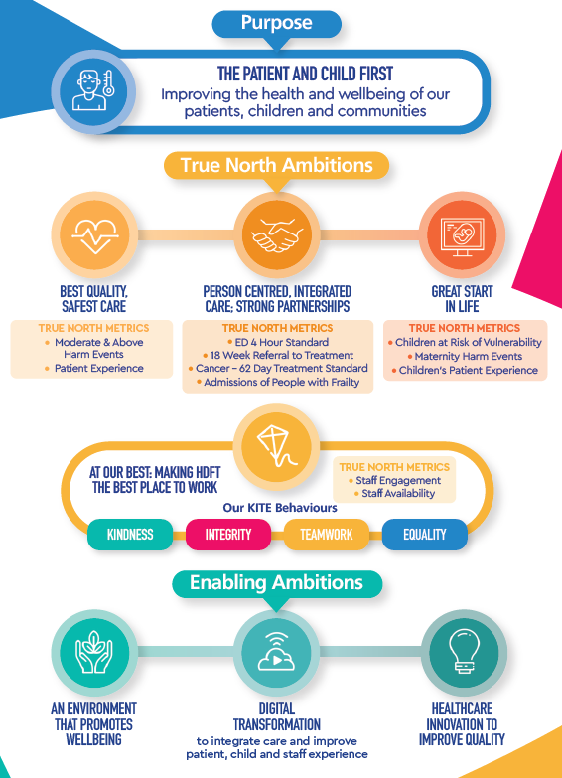
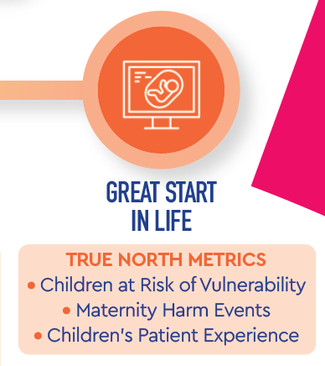
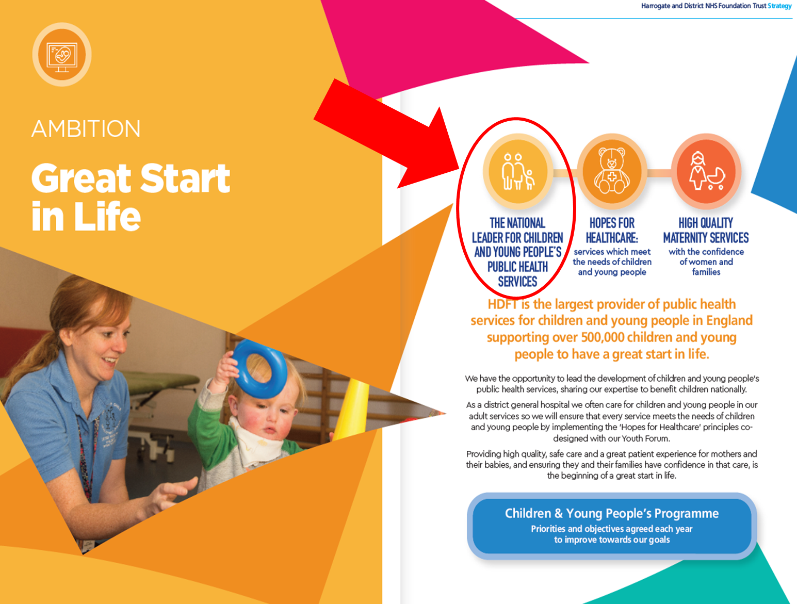
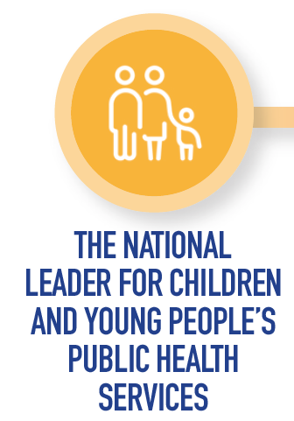



Our Children’s Public Health Services Strategy Is Integral To Our Trust Strategy

Slide 7
Our Children’s Public Health Services Strategy
HDFT is the largest provider of public health services for Children and Young People in England supporting over 600,000 Children and Young People to have a great start in life. We have the opportunity to lead the development of Children and Young People’s public health services, sharing our expertise to benefit Children and Young People nationally. Our size and expertise in Children and Young People’s public health services creates a unique opportunity for us to be the leading NHS trust partner for research into children’s public health services. Recognising our strengths and opportunities, and combining the ambitions from our overall Trust Strategy together, we have identified three ambitions for our Children’s Public Health Services Strategy:
To deliver great outcomes and impact for our children and young people.
To be an outstanding partner in every system where we provide services.
To be a leading voice and advocate for children’s public health services, locally and nationally.
These three ambitions will be delivered through eight goals:
A bespoke clinical model for each community we serve, which meets local needs while using our scale to provide resilience and expertise.
Listening to and acting on the voice of the Children and Young People we support
An operational model specifically designed to support dispersed, community services.
A focus on retention, reform and training to grow and develop our own children’s public health workforce.
Broadening our core public health nursing offer through integration with or provision of complementary services
Building long-term partnerships in every system in which we operate
Measuring the outcomes of our services for the Children and Young People we support
Building an evidence base, through robust academic research, for what works in children’s public health services

Slide 8
Our Children’s Public Health Services Strategy
Bespoke Clinical Model
(Local need with resilience and expertise through scale)
Listening to and acting on the voice of the children and young people we serve
Delivering great outcomes and impact for our Children and Young People
Operational Model designed for dispersed, community services
An outstanding partner in every system
Developing our workforce through retention, reform and training.
Broadening our service offer through complementary services
A leading voice and advocate for Children’s Public Health Services
Building long-term partnerships with system partners
Measuring the outcomes of Children’s Public Health services
Building the evidence base for Children’s Public Health services

Slide 9
Our Clinical Model - A Model Built On Strong Foundations
We combine strong system leadership, clinically excellent, evidence-based and prevention-focused care, with proactive, integrated One Team partnership working. Our models are universal in reach and personalised in response. We engage with Children, Young People and Families, from pre-birth to age 19(25), offering access to universally available care pathways. Those at higher risk and with greater need will receive tailored resources through an innovative skill mix team, via Targeted and Specialist Level pathways, responsive to their evolving unique needs: driving positive outcomes, reducing health inequalities and building early, sustainable resilience. We are the UK’s largest provider of successful Children’s Public Health services, with CQC rated Outstanding services. We believe Children’s Public Health services must be designed and delivered based on six fundamental principles:
Clinically excellent care
Proactive prevention
Proportionate Universalism
Whole system leadership
Service user centricity
A staff wellbeing focus
These principles underpin how we design and deliver truly bespoke, locally-responsive models; harnessing service user, district, regional and national data to meet strategic, operational, and, most importantly, individual need.

Slide 10
Children and Young People: The Voice of Lived Experience
Engaging Children and Young People in Services Co-Design As experts by experience, our Children, Young People and their Families must have the influence to shape our services to meet their needs. Feedback from parents and young people via digital surveys, forums and other engagement activity will feed into our continuous improvement cycle, informing needs-led service development and improvement. In 2024 we will be completing a 12-month “Children and Young People’s Voice” project to develop and implement a framework and processes to improve how we listen to and act on feedback from Children, Young People and their Families. We will be engaging with Children And Young people from all areas of our diverse geography to explore what is important to them, what a great service looks like and to co-create a Children and Young People’s Patient Experience Tool. We will be holding ten focus groups: one for each of our Children’s Public Health services local authority areas and one for our acute services.
Each group will include 6-10 young people aged 11+, facilitated by youth workers and our children and young people’s patient experience leads. Together the groups will present a proposal for the Children and Young People’s Patient Experience Tool.
From the project, the groups will become local Children and Young People’s committees, and representatives from each group will come together to form a trust wide Children and Young People’s Board. Group members will be our “Great Start in Life Young Advisors”.
Notes:
I think we need to i

Slide 11
An Operational Model For Dispersed, Community Services
HDFT now provides children’s public health services across nine local authority areas in Yorkshire and the North East, from Berwick on Tweed in the North to Wakefield in the South and from Settle in the West to Scarborough in the East – an area the size of Macedonia with over 600,000 young people and their families to support. We have built an operational model specifically designed to support widely dispersed, community services, and we are continuing to refine and develop the model:
Additional, dedicated corporate services for community services.
IT designed to support efficient, agile, mobile working by enabling clinicians to connect from a base, from a service user’s home and from their own home. IT support available locally.
Team processes and systems designed for remote working through Microsoft Teams.
HR support available locally, through dedicated HR partners available on site or via Teams.
Partnerships with other local providers for occupational health and workplace vaccination.
Availability of office bases so teams can meet in person, as well as remotely.
Dedicated community estates team, including health and safety.
Developing a community estates strategy including improved helpdesk support for staff.

Slide 12
Developing Our Workforce – Retain, Reform, Train
As the largest provider of Children’s Public Health services in Yorkshire and the North East, HDFT has to grow and develop its own Children’s Public Health nursing workforce – we know recruitment alone is not the answer.
Retention - Retention is a focus throughout HDFT and our 2023 NHS Staff Survey results indicate that staff engagement and morale have improved significantly. We will continue to improve retention by:
Managing safe staffing levels using our HDFT developed Demand and Capacity Tool and operational escalation level Operational Pressures Escalation Level (OPEL) Framework
Supporting staff wellbeing through monthly 1-1 Quality and Performance Management Supervision and wellbeing conversations for every member of staff
Offering flexible working and career development
Reform - The NHS Long Term Workforce Plan sets an ambition to “work differently” and HDFT has introduced a range of innovative, skill mixed roles alongside our Specialist Community Public Health Nurses (SCPHN): Community Anchors, Youth Practitioners, 0-19 Speech and Language Therapists and Emotional Health and Resilience Nurses. These roles support our SCPHNs and enable them to focus on their specialist clinical work, while offering new career paths and development opportunities within our children’s public health services. We also continue to seek opportunities to use digital systems to optimise pathways, administration and patient information, while always being mindful of digital exclusion and remembering that public health nursing is best done face to face and through home visits. Our robust governance, learning and quality improvement processes maintain high standards while delivering innovative workforce models to meet the diverse needs of communities in every area we serve and enabling us to respond flexibly to changing legislation, policy, funding and technology
Training - Every year HDFT trains over 60 SCPHNs and we need to train more to continue to reduce vacancies. We plan to continue to increase our placement numbers, including offering SCPHN apprenticeships, to support the NHS Workforce Plan ambition to increase training places by 74% by 2031. Subject to qualification, all our SCPHN students are guaranteed a permanent contract at the end of their course. To develop career paths into public health nursing we also offer Year 3 student nurse placements and direct entry staff nurse (band 5) roles. For our non-registered roles we will also explore nurse associate training opportunities to support their career development.

Slide 13
Broadening Our Service Offer Through Complementary Services
HDFT’s purpose, set out in our Trust Strategy, is to always put the patient and child first, and to improve the health and wellbeing of the patients, children and communities we serve. We believe our innovative approach to providing Children and Young People’s Public Health Services can support families to give their Children and Young People a great start in life.
We will continue to seek opportunities to provide Children and Young People’s Public Health services where we are confident that we can provide a high quality service and can improve outcomes for children.
Alongside our core children and young people’s public health services we will also seek opportunities to broaden our service offer through integration of complementary children’s services. For instance, we currently provide oral health promotion and children in care services in some of our systems.

Slide 14
Building Long-term Partnerships In Every System
HDFT is committed to being an outstanding partner in every system in which we work. We know that partnership working is fundamental to successful delivery of children’s public health services and to ensuring every child and young person has a great start in life.
We want to build long-term partnerships with local authorities, other NHS providers and the communities we serve which enable us to go beyond excellent service delivery against our contracts. Long-term partnerships will allow our services to invest, innovate and integrate with partners in each system to benefit the Children, Young people, Families and Communities we serve.
We will:
Build strong strategic relationships between HDFT Executives, Community and Children’s Triumvirate Team and Local Authority Directors of Public Health and Directors of Children’s Services.
Ensure executive attendance at Health & Wellbeing Boards or other partnership forums where HDFT is a member.
Develop and maintain consistent operational and clinical relationships between HDFT senior management teams, local authority commissioners and system partners.
Build our national profile with NHS England, professional bodies and other stakeholder to influence the development and highlight the importance of public health nursing.

Slide 15
Measuring The Outcomes Of Children’s Public Health Services
Traditionally, and in our contracts, Children’s Public Health services are measured through on time delivery of the mandated contacts in the Healthy Child Programme. The Healthy Child Programme is evidence based so delivery of the contacts should lead to better outcomes for Children and Young People, but we should recognise that these are proxy measures for outcomes, not measures of real outcomes. Developing outcome measures for Children’s Public Health services is challenging when so many factors outside the services’ control affect outcomes, but we believe we can do better.
We will:
Benchmark our mandated contacts key performance indicators with other providers nationally.
Measure how many children, identified as at risk of vulnerability at the first post-natal visit, have transitioned to universal services by 2.5 years.
Develop a rich measure of Children and Young People’s experience of our services
Work with academic, national and system partners, and Children, Young People and Families to develop and implement more sophisticated outcome measures and frameworks, building on existing work such as the Common Outcomes Framework (by Kindred Squared), the Overall Paediatric Health dataset (by International Consortium for Health Outcomes Measurement).

Slide 16
Building The Evidence Base For Children’s Public Health Services
At HDFT we believe that innovation, based on evidence, is a key part of improving quality of care and delivering our purpose to improve the health and wellbeing of the patients, children and communities we serve. Evidence indicates that organisations which are involved in research deliver better quality care.
As the largest provider of Children’s Public Health services in England, supporting over 600,000 Children, Young People and their Families, we have a unique opportunity to be the leading NHS trust partner for research into Children’s Public Health services. We want to expand the evidence base for what works in Children’s Public Health services to help providers deliver better outcomes for children throughout England and internationally.
We have already opened three new research studies in children’s public health:
Early Language Identification Measure and Intervention (ELIM-I) study
Evaluation of the HENRY sustainable obesity prevention programme
Born and Bred In (BaBi) Harrogate – a cohort study recruiting mums and babies, then following them through to adulthood.
We will continue to seek opportunities to open further studies and to develop a long-term research partnership. We are also seeking an academic partner to support evaluation of our Safe Staffing Framework and tools (Demand and Capacity, Operational Escalation Level (OpEL) framework, Quality and Performance Management Supervision).

Slide 17
Our Children’s Public Health Services Strategy - Summary
HDFT is the largest provider of Public Health Services for Children and Young people in England supporting over 600,000 Children and Young People to have a great start in life. We have the opportunity to lead the development of Children and Young People’s Public Health services, sharing our expertise to benefit Children and Young People nationally. Our size and expertise in Children Public Health services creates a unique opportunity for us to be the leading NHS trust partner for research into Children’s public health services.
Recognising our strengths and opportunities, and combining the ambitions from our overall Trust Strategy together, we have identified three ambitions for our Children’s Public Health Services Strategy:
To deliver great outcomes and impact for our Children and Young People.
To be an outstanding partner in every system where we provide services.
To be a leading voice and advocate for Children’s Public Health services, locally and nationally.
These three ambitions will be delivered through eight goals:
A bespoke clinical model for each community we serve, which meets local needs while using our scale to provide resilience and expertise.
Listening to and acting on the voice of the Children and Young People we support
An operational model specifically designed to support dispersed, community services.
A focus on retention, reform and training to grow and develop our own Children’s Public Health workforce.
Broadening our core public health nursing offer through integration with or provision of complementary services
Building long-term partnerships in every system in which we operate
Measuring the outcomes of our services for the Children and Young People we support
Building an evidence base, through robust academic research, for what works in Children’s Public Health services

