Slide 1

Harrogate & Hambleton & Richmondshire Autism Assessment Service
Update on service changes: Please watch using slide show for audio narration
Specialist Children’s Services Autism Assessment
https://www.hdft.nhs.uk/services/childrens-services/specialist-childrens-services/autism-assessment/
Notes:
The Harrogate and Hambleton and Richmondshire autism assessment service is making some important service changes and this presentation is going to explain:
what we are changing and why, and how we think this will be much better for children, young people their families and the professionals who support them.

Slide 2

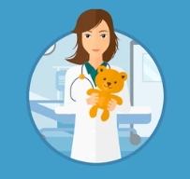

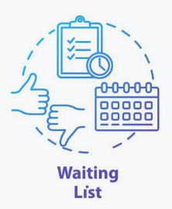

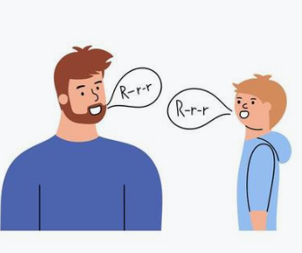
Previous Pathway
For the full pathway through the service, see Appendix 1
Notes:
In our existing pathway, if you were seeking an autism assessment you had 2 main routes to get into our service: The most common option was approaching your GP who would refer you to a paediatrician. There would usually be a waiting list for this. If the paediatrician agreed to refer you on to the autism assessment service, you would then wait on our waiting list until we were able to complete the autism assessment.
The other route was through CAMHS or specialist children's services for example speech and language therapy.
For most families, this meant that there was a wait which was sometimes substantial before you even got onto the waiting list for an autism assessment, and there was often confusion when families were waiting to see the paediatrician but thought they were waiting for the actual autism assessment.
Our aim as a service is to make the assessment Pathway much more accessible, offering a better experience for children, young people and their Families.
We are not expecting that these changes to our service will reduce our waiting times as we do not have enough capacity to meet the need and we are actively working with Commissioner's of our service to try and resolve this challenge.

Slide 3
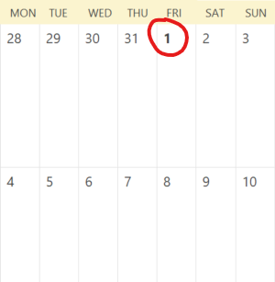
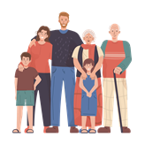


Referral process changes
From 1st September 2023, the HDFT Autism Assessment Team will have an open referral system
Young person self-referral (age 16&17)
Professional Referral
(with CYP/ family consent)
Family referral for child/ young person
https://www.hdft.nhs.uk/services/childrens-services/specialist-childrens-services/autism-assessment
You must have consent from the child's parent or legal guardian if the child is under 16 and you must also have consent from the young person if they are 14 or older.
Notes:
So what do these changes mean for you?
The good news is that from the 1st September you can make a referral for your child (or you can self refer if you are 16 or 17 years old).
All the information and referral forms are available on our website which will be split into 3 sections:
one for families
one for young people
one for professionals.
We encourage families to complete the referral if you can (perhaps with support from someone working with you, or from our team). Young people aged 16 & 17 can self refer and younger children can contribute to their referral and share their ideas and hopes for assessment using the “All about me” form.
Anyone working with you can also make a referral to the autism assessment service if you give them permission.

Slide 4


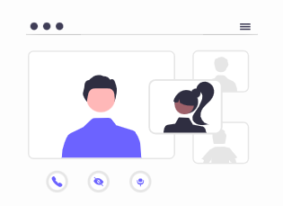



What will happen after referral
Notes:
What happens after the referral?
Practitioners in our autism assessment service will be available to support you if you are struggling to fill in the referral form - we will offer a range of communication methods.
You can ask professionals working with you to send information through our website to support your referral
Once a fully completed referral is received by our team, the information is triaged by a multidisciplinary panel which includes members of the autism assessment service, a consultant paediatrician, and a colleague from the Early Help team. The information will be reviewed to decide whether an autism assessment is appropriate at this stage and to develop an individualised resource plan. At this meeting, we will also decide whether it is appropriate to take the referral to a Multi-Agency meeting to agree whether a referral to other services may also be appropriate. This meeting may include Child & Adolescent Mental health Services (known as CAMHS), Social Care, Compass, Healthy Child Team, Wellbeing in Mind Teams and other local service providers.
After the triage meeting, we will send you a personalised letter to let you know if we have accepted the referral for an autism assessment or not,. This letter will also include relevant sources of support you can access while waiting. We may also suggest onward referrals at this point.

Slide 5


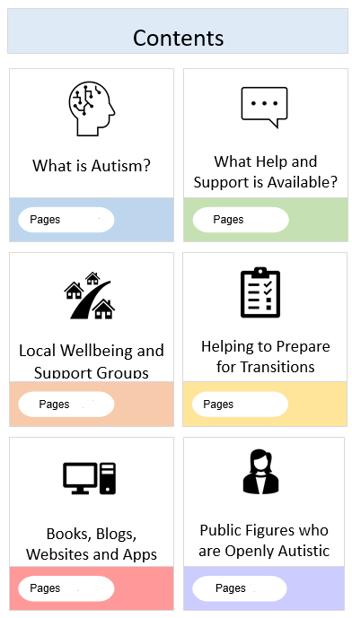
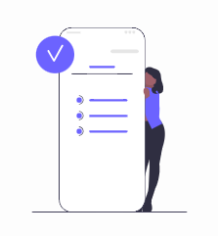
Waiting list support
Solihull Approach: helps to better understand a young person’s development and emotional well-being. Online courses and face to face groups for parents. Register using the code NYFAMILIES at:
https://inourplace.co.uk
Notes:
We are working hard to support families on our waiting list.
At the triage meeting, we will agree which resources/ other services may be most useful for you to access – this will be sent out to you with either an acceptance or rejection of the referral.
This will include access to the Solihull online parent training, and may include the unlocking autism course and other resources
We may suggest referrals on to other relevant professionals
Our website has lots more resources you can access during the wait

Slide 6

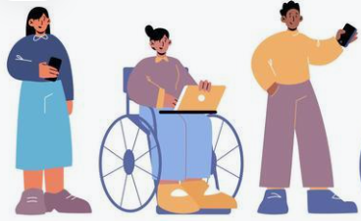
Assessment
Pre-School pathway:
Single 90 minute appointment
Child & parent(s)/ guardians
History taking & play based assessment
Outcome given in session
Report follow
Patient-Initiated follow-up session
School age pathway:
Clinic session: activity based assessment with child/ young person
Parent/ Carer Interview
Information from education
MDT Forum
Feedback appointment(s)
Report follow
Patient-Initiated follow-up session
https://www.hdft.nhs.uk/services/childrens-services/specialist-childrens-services/autism-assessment/
Notes:
Depending on the age of your child, the assessment will look a little different:
Preschool children will be brought in for a single, longer appointment with their parents or guardians. At this appointment we will complete both the parent interview and play based assessment with the child. We will aim to give families the outcome of their assessment in this same appointment and then we will offer a further feedback appointment if you want the opportunity to talk without your child present
Children of school-age will be offered a clinic appointment. We will do a parent interview and request information from education.
We are making our assessments more neurodiversity affirmative and moving away from the deficit model of autism.
On both pathways, we will offer a patient initiated follow-up session after we have shared the outcome of the assessment, and we will send a report to you and your GP.
Our website and You-tube channel will have lots more resources and helpful links you can access from 1st September.
Please do not send any direct referrals before 1st September as we are unable to accept or process these until 1st September.

Slide 7
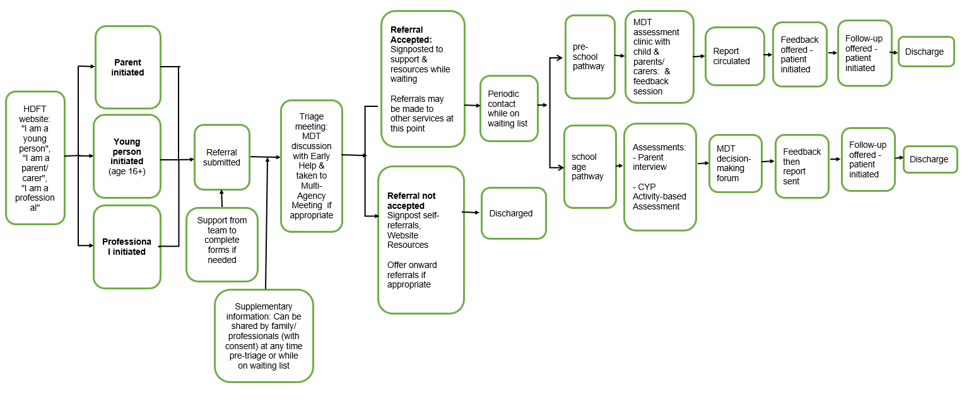
Annex 1: Complete Pathway from 01/09/2023

